Slide 1
B-Line Security System
Vehicle Security http://b-linesecurity.com/
University of Utah
Electrical Engineering Students
Travis Jeppson
Clinton Mullins
Hwan-June Cho

Slide 2
Car Controller Module
Arduino microcontroller state machine code under development.
Enumeration of states
Required input/outputs
*Arduino is the name of our selected Micro Controller

Slide 3
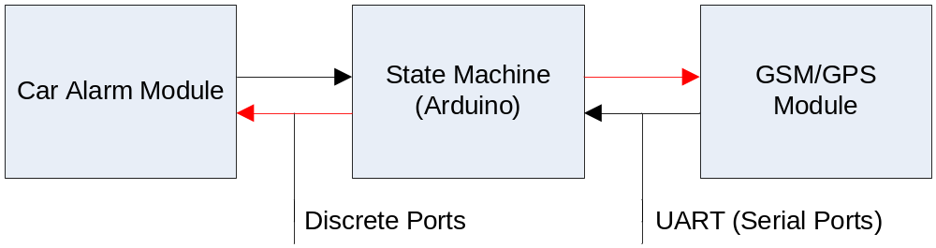
High Level Block Diagram
Monitor from Car Module: Input/Output:
Doors Locked/Unlocked I/O
Doors Open/Closed I
Ignition Status I
System Health I
Alarm Set I/O
Alarm Triggered I
Alarm Clear O

Slide 4
High Level Block Diagram
Line Description | Pin # | Pin Type
door_unlock_R | 22 | Digital
SW_door_unlock_R | 2 | Analog
door_lock_R | 23 | Digital
SW_door_lock_R | 3 | Analog
door_check | 5 | Analog
to_door_check | 24 | Digital
light | 11 | PWM
horn | 10 | PWM
ignition_check | 4 | Analog
to_ignition_check | 25 | Digital
alarm_trigger | 26 | Digital

Slide 5
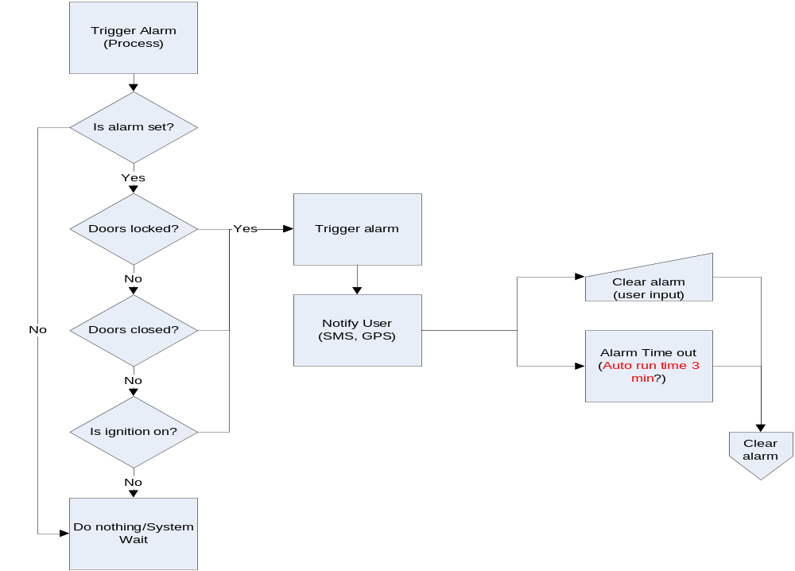
Alarm Trigger Process

Slide 6
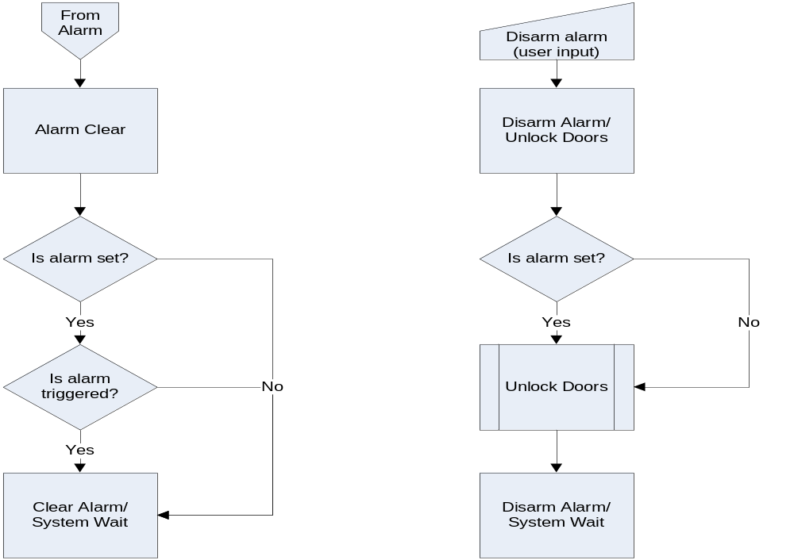
Clear/Disarm Alarm Processes

Slide 7
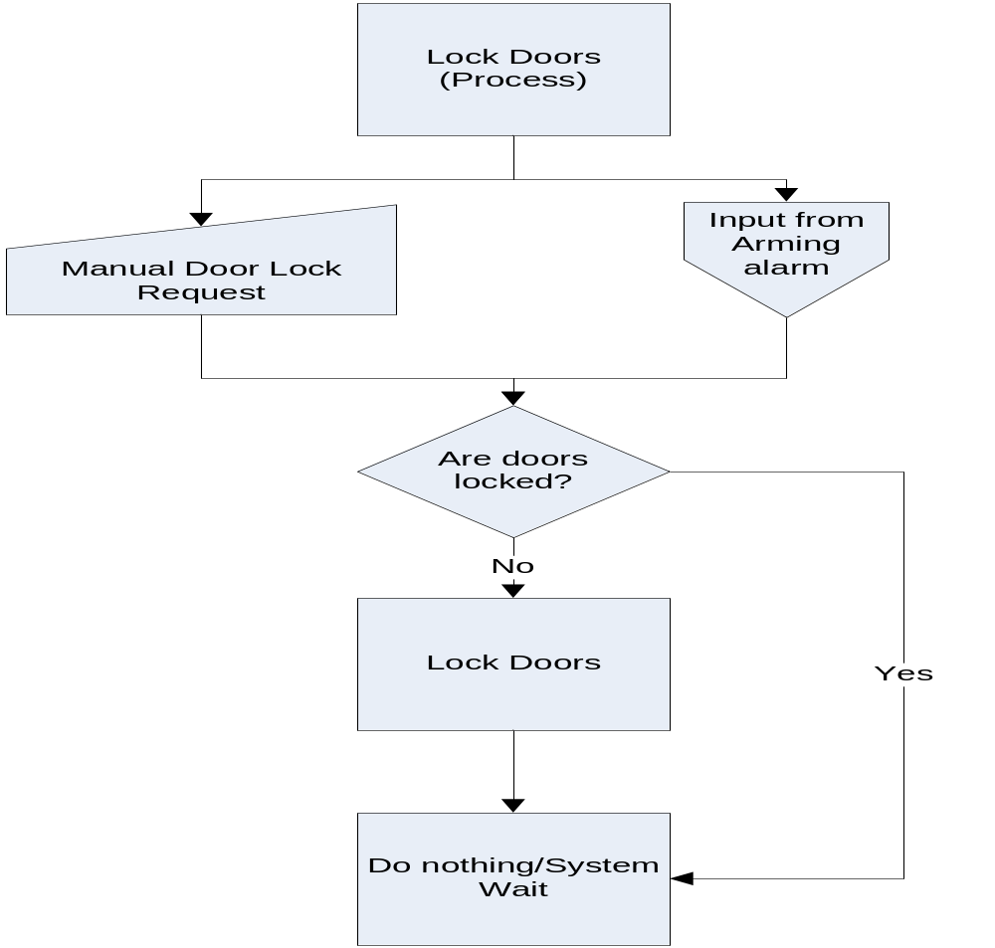
Lock Door Process

Slide 8
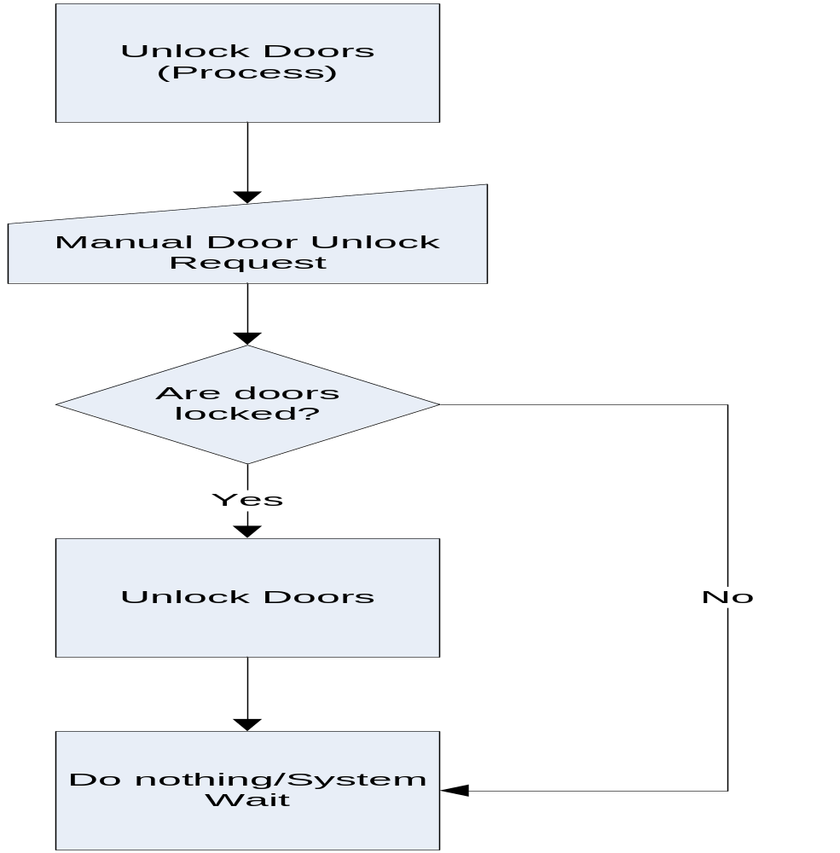
Unlock Door Process

Slide 9
Tasks Remaining
Finalize state machine code
  Basic structure in place
  Move car alarm functions to its own class (aesthetics)
Add wireless GSM states
  Create pin diagram for hardware
  Plug in communications to block diagrams

